Slide 1
Analysis of Laboratory Notebook Practices of General Physics Students
Michael Zwartz, Lewis University
Dr. Joseph Kozminski, Lewis University
https://goo.gl/vb5Lpj

Slide 2
AAPT Laboratory Recommendations
Developing technical and practical laboratory skills
Introductory level: “Students should be able to record and organize their observations, data, and results in preparation for keeping a laboratory notebook.”
Example: “Introductory students could record a description/ sketch of the apparatus, the measurement procedure, data, and analysis.”
Advanced level: “Students should maintain laboratory notebooks of sufficient quality for beginning graduate level research.
https://www.aapt.org/Resources/upload/LabGuidlinesDocument_EBendorsed_nov10.pdf
https://goo.gl/vb5Lpj

Slide 3
Assessing Undergraduate Laboratory Performance
Elizabeth M. Adler, Nancy R. Gough
Laboratory notebooks are an important piece of scientific communication
Each entry should include the following information: Date, Title of the Lab, Background, Purpose, Methods, Results, and Conclusions.
Grades based on student understanding of the experiment rather than on whether or not it “works”
Notebooks help prepare posters, presentations, and other forms of scientific communication
https://goo.gl/vb5Lpj

Slide 4
Lab notebooks as scientific communication: investigating development from undergraduate courses to graduate research
Jacob T. Stanley, Heather Lewandowski (University of Colorado-Boulder)
Interviewed physics graduate students about their undergraduate experience with laboratory notebooks
Found that most students did not receive adequate training
Were lacked the scientific documentation skills when beginning graduate school
Graduate students learned the practices through hand-on practice in an authentic research environment
Another common theme was that their undergraduate lab grades were not based on their lab notebooks
https://goo.gl/vb5Lpj

Slide 5
objectives:
Discover if Lewis University undergraduates are receiving the proper training they need in order to develop the scientific documentation skills for graduate level research.
To learn what teaching strategies best help students learn the proper laboratory notebook practices.
Explore students attitudes on laboratory notebooks.
https://goo.gl/vb5Lpj

Slide 6
What did we do?
Survey to explore student’s attitudes, beliefs, and practices are regarding laboratory notebooks.
Pre- and Post- surveys given to undergraduate students taking any physics lab.
Labs include General Physics I, II, III, and Intermediate Physics Lab

Slide 7
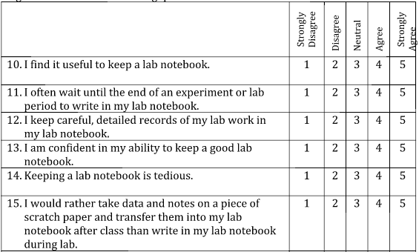
About the Survey
Pre survey:
4 questions for demographic information
30 Likert-style questions
1 short answer
Post Survey:
35 Likert-style questions
7 short answer
Ex: What training/instruction did you find most helpful in this lab section?

Slide 8
Method of analysis
Two tailed t-test with a confidence level of 0.05
Categorized short answer responses
Students are tracked through their undergraduate courses
Race/Ethnicity
White | 57.7%
Black | 4.2%
Hispanic/Latino | 19.7%
Asian | 11.3%
Native Hawaiian/ Pacific Islander | 0.7%
Other | 1.4%
Prefer not to answer | 2.8%
Gender Identity
Male | 59.9%
Female | 39.4%
Prefer not to answer | 0.7%

Slide 9
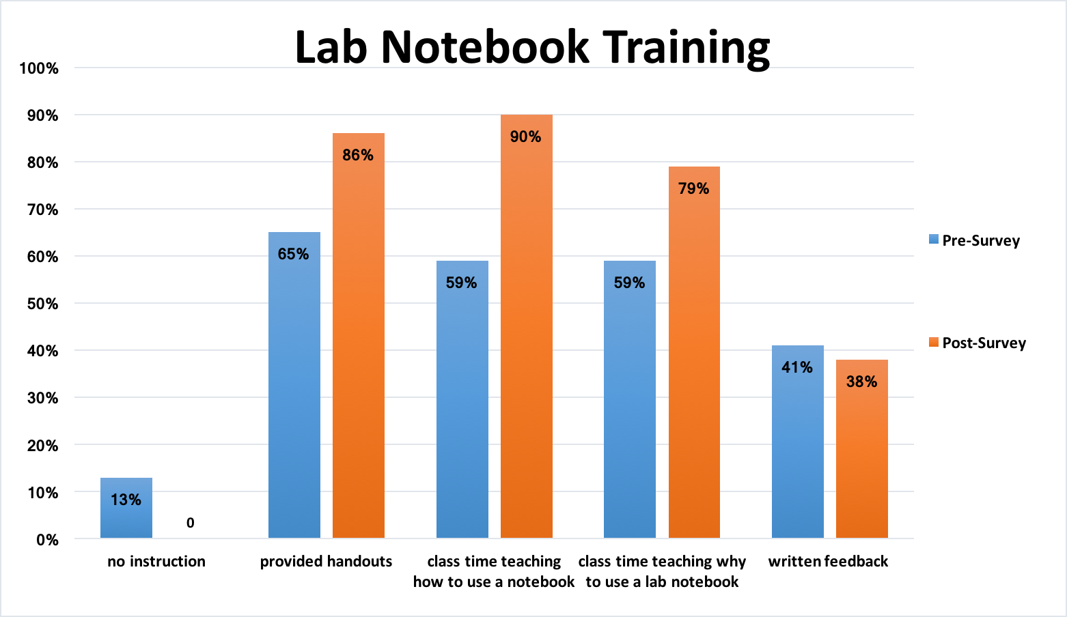
Initial results
After one semester of data we see students getting much more training than before
N = 66
Previous Experience
Experience in high school | 45%
Some experience in college | 25%
No experience | 29%

Slide 10
Initial Results (cont.)
Attitudes on data handling improved with one semester of training

Slide 11
Previous Lab experience

Slide 13
Significant improvement for “I often wait until the end of an experiment or lab period to write in my lab notebook.”
Agreeing students increased by about 20% and the data has a calculated p-value = 0.033

Slide 14
Student response – Pre Survey
Describe what kind of training you have received prior to the current semester.
“Most of my instruction on how to better maintain a lab notebook has come from me seeking help outside of class.”
“Instructors have provided written/verbal reasoning on what I have may missed point wise but not any feedback on improving those skills.”

Slide 16
Student response – Post survey
What training/instruction did you find most helpful in this lab section?
Outline/Rubric
“The rubric for grading the lab notebook which was very detailed and outlined described exactly what was needed in lab notebook.”
Purpose
“Explaining why good lab notebook practices are necessary in the real world.”
Handout
“The handout with a specific checklist of what needs to be in the pre-lab, the lab, and the summary was extremely beneficial, I used it for every lab”
Specific Task Training
“How to actually put graphs/tables in a lab notebook and reference them.”

Slide 17
Suggestions to improve instruction

Slide 18
Student response – Post Survey
None
“I had great feedback, no improvement necessary.”
Examples
“Show examples of a good and bad lab report.”
“Have an example of what a 60/60 lab report looks like.”
Improved Feedback
“More feedback on what specifically needs improvement.”
“The only improvement would be a quicker return time, so improvements could be made.”

Slide 19
Conclusion
So far in this study we have identified areas to work on.
Look for more longitudinal to track notebook practices from introductory level through capstone to see the whole trajectory
Group last year will be moving to intermediate and we can look at the groups who have had specific training compared to those who have not had training
Students like when they get specific feedback on how to improve their notebooks

